Slide 1
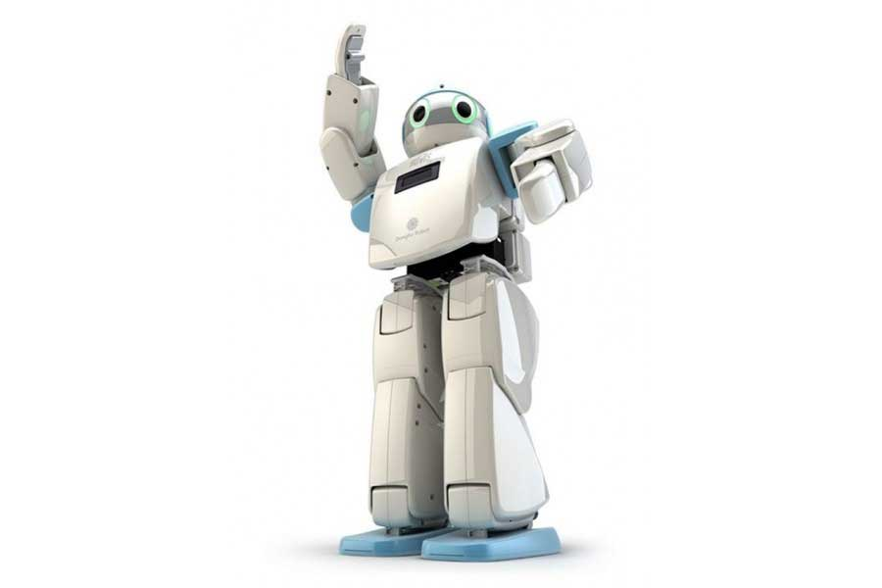
SKYLINE INSTITUTE OF ENGINEERING AND TECHNOLOGY GREATER NOIDA
PROJECT PRESENTATION ON
HUMANOID ROBOT
PRESENTED BY:- MOHD MONISH
ADITYA SINGH
GOVIND SINGH
ATIQUR RAHAMAN
VINEET JAISWAL
MAYANK RAI
(MECHNICAL 4TH YEAR )
GUIDANCE BY:- ER. ANKIT MANI TRIPATHI
(FACULTY MECHANICAL DEPARTMENT)

Slide 2
CONTENTS
HISTORY
OBJECTIVES
INTRODUCTION
BASIC MATERIAL REQUIREMENTS
SERVO MOTOR & HOW IT WORKS
ARDUINO CIRCUIT

Slide 3
HISTORY

Slide 4
OBJECTIVE
Our Aim is to built a Robot, Which can shake hand walk and provide some moments to it.
It can do some simple task like to turn when obstacles came in play while moving the robot.
FUTURE ASPECTS & PERFORMANCE OF THIS ROBOT
In Future we can modify it circuit & do programming for increasing the flexibility of this Robot.
We are going to modify its degree of freedom.

Slide 5
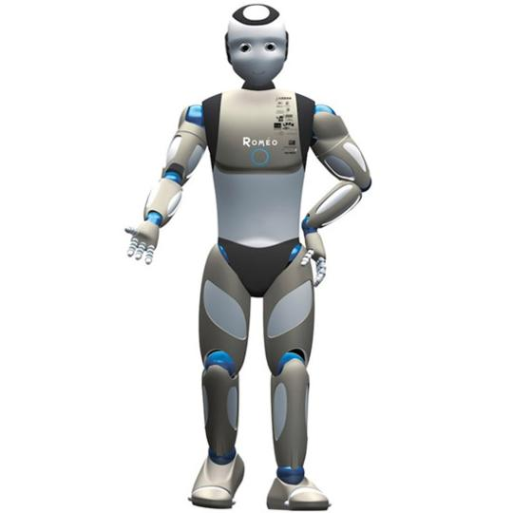
A robot is a re-programmable multifunction manipulator designed to move materials, tools or specialized devices through variable programmed motions.
WHAT IS ROBOT?
WHAT IS HUMANOID ROBOT?
A humanoid robot is a robot with its body shape built to resemble the human body, having torso, two legs, a head & two arms.

Slide 6
BASIC MATERIAL REQUIREMENT
SERVO MOTOR
ARDUINO CIRCUIT
ULTRASONIC SENSOR
ACCELOMETER (3-AXIS)
GYROSCOPE (3-AXIS) SENSOR
BATTERY (LIP0 3s 5000mAH 11)
BEC (BATTERY ELIMINATOR CIRCUIT) OUTPUT (5v 8A)
LOGIC CONVERSOR (communication between UDOO arduino due(3,3v) and the servo controller(5v))

Slide 7
HOW SERVO MOTOR WORKS IN HUMANOID ROBOTS?

Slide 8
HOW ARDUINO CIRCUIT WORKS?

